Slide 1

SAU STUDENT DEAN'S OFFICE
Assoc. Prof. Dr. Havva Sert
Student Dean
www.sakarya.edu.tr

Slide 2

STUDENT DEANSHIP
To create a university environment where students can fully utilize their personal, professional, and educational potential, cultivating individuals who feel the honor and privilege of being a Sakarya University graduate.
To support the academic, social, personal, and cultural development of our students, enhance institutional belonging, facilitate university life, and provide effective solutions to student issues to foster a dynamic campus environment.

Slide 3
STUDENT DEANSHIP
Providing information to the University Executive Board and Senate on relevant topics when deemed necessary by the Rector and preparing proposals and drafts on these matters as needed is among the objectives of the Student Deanship.

Slide 4
SAU DEANSHIP
Tel: 02642953963
Fax: 02642953110
ogrdekan@sakarya.edu.tr

Slide 5
STUDENT DEANSHIP
Listens to students' problems regarding university life, seeks solutions to problems in cooperation with relevant administrative and academic units,
Assists in ensuring coordination between academic and administrative units that directly concern students,
Evaluates and directs students' academic, social and administrative applications regarding campus life

Slide 6
STUDENT DEANSHIP
Supports the creation of a more effective and efficient learning environment,
Assists in coordinating common elective courses and exams,
Oversees the control and updating of the education ınformation system (EBS),
Prepares recommendations, drafts, regulations, and guidelines related to education.

Slide 7
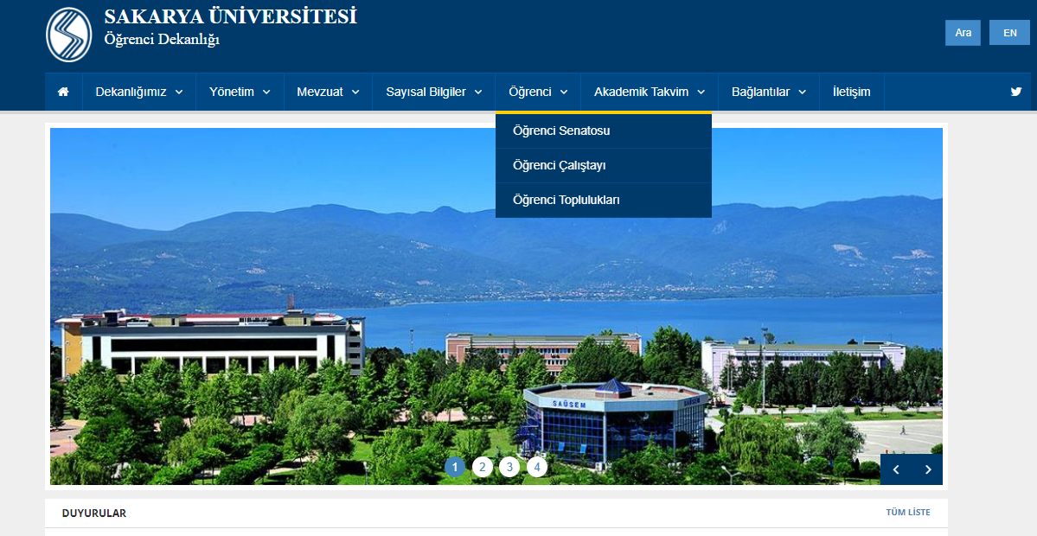
STUDENT DEANSHIP
Established within our university's student-oriented perspective, the Student Senate aims to enhance student contributions for healthier institutional development. Suggestions presented in the Student Senate are implemented by the Student Deanship. Strategic topics and decisions are conveyed by the Student Deanship to the University Senate and University Executive Board.

Slide 8
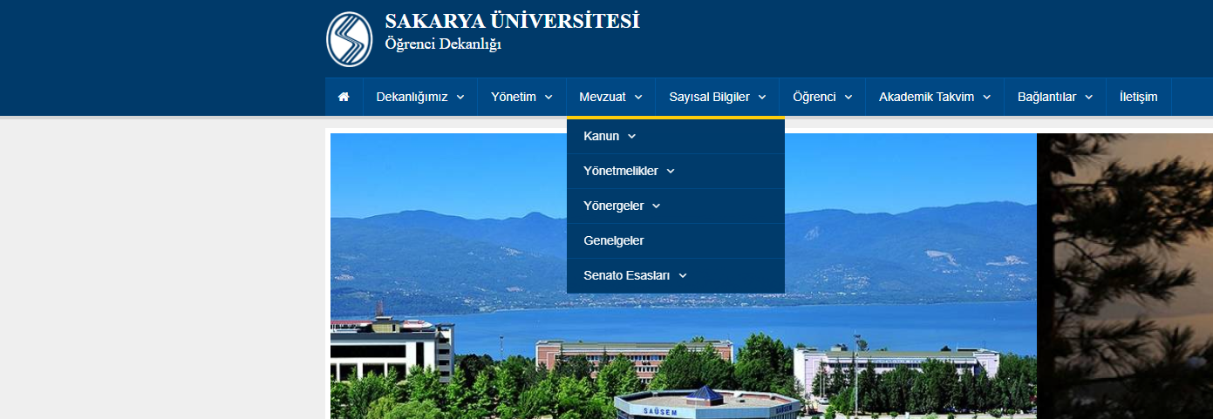
STUDENT DEANSHIP

Slide 9

STUDENT DEANSHIP

Slide 10
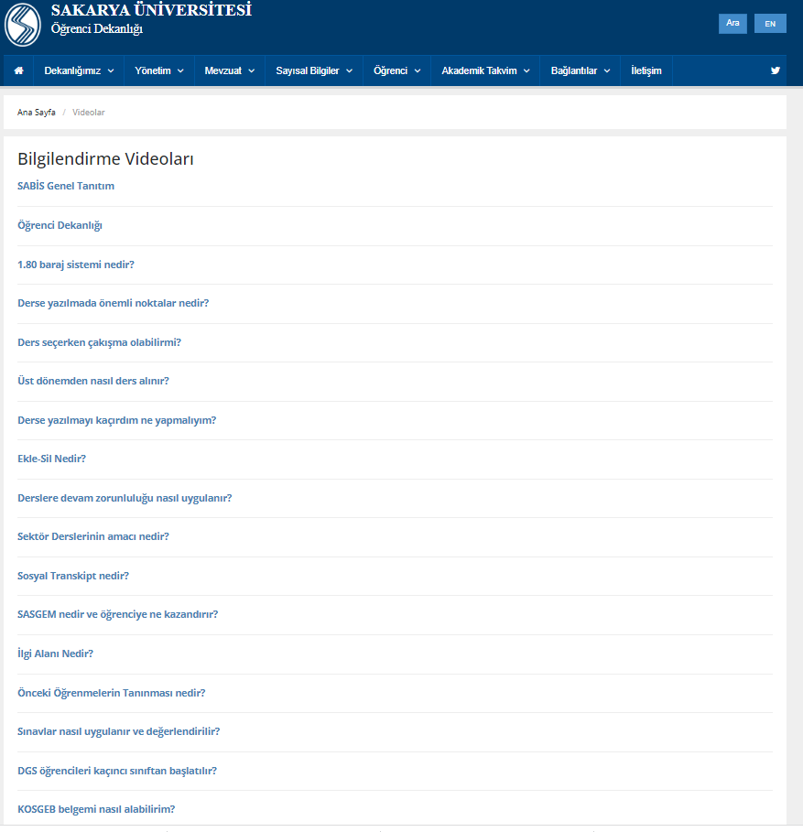
THANK YOU FOR YOUR ATTENTION
www.sakarya.edu.tr
THANK YOU FOR YOUR ATTENTION
www.sakarya.edu.tr

Slide 11
THINGS TO CONSIDER
www.sakarya.edu.tr

Slide 12
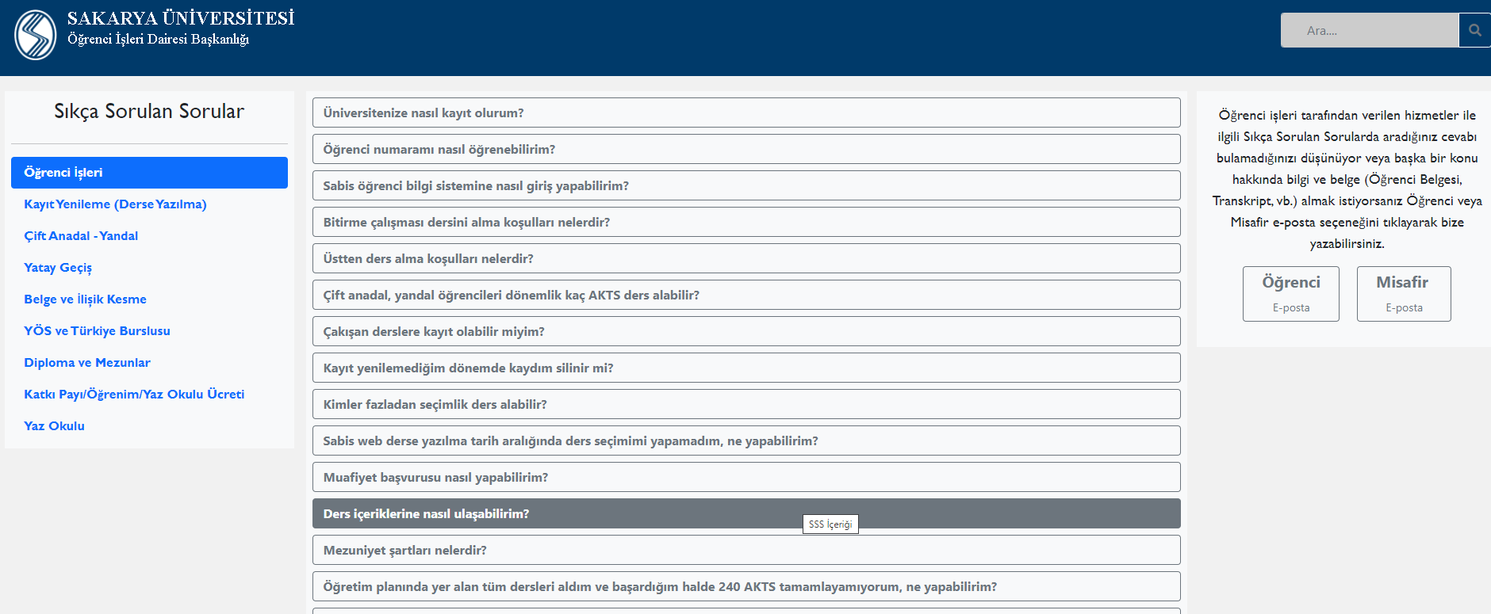

Slide 13
THANKS FOR YOUR INTEREST
www.sakarya.edu.tr

